Slide 1
The Electoral College
Student’s Name
Institutional Affiliation
Date

Slide 2
Introduction
The Electoral College is a body of electors that forms every four years to elect the president and the vice president of the United States.
In the Electoral College system, each state gets a certain number of electors based on its total number of Congress representatives (Amar, 2007).
Each elector casts a single vote following the general election, with a candidate requiring a simple majority to win the election.
Since there are 538 electoral votes, a candidate who gets more than half (270) becomes the winner.
This presentation uses the 2016 US Presidential election to argue against the use of the Electoral College in deciding presidential winners.
Notes:
The framers of the constitution established the Electoral College to determine the winner of the US presidential election to protect the dominance of larger populous states like California, Pennsylvania, and Virginia (Amar, 2007). It was a measure meant to protect small states like Lowa. Each of the states is given a certain number of votes based on the total number of Congress representatives. Overall, there are a total of 538 college votes. For a candidate to be declared the winner, he/she has to garner a half of the college votes which is 270. Even if a candidate wins the popular vote but fails to get more college votes than the opponent, the opponent will be declared the winner even if he/she has fewer popular votes.

Slide 3
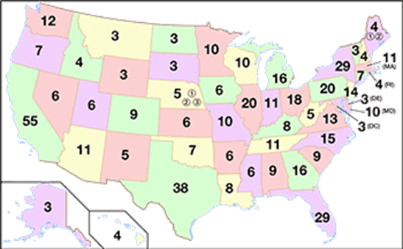
Electoral votes allocated to each state
This map shows the number of electoral votes allocated to each of the 50 states in the United States.
Notes:
This map shows the distribution of electoral college votes across the 50 states. For example, California is allocated 55 votes, Texas 38 votes, Florida 29 votes, New York 29 votes, New York 29, Pennsylvania and Illinois each 20 votes. States with very few votes include Hawaii and Idaho (4 votes), Alaska, Delaware, Montana, Wyoming and South and North Dakota (3 votes). It is important to note that these votes were distributed based on the 2010 census and were effective for 2012, 2016, and 2020 presidential elections.

Slide 4
The 2016 U.S Presidential Election
The 2016 US Presidential election was one of the elections in which the candidate who won the popular vote failed to get the required electoral college votes hence losing the presidential election.
Despite winning the popular vote by 65,844,610 votes, Hilary Clinton did not become the US president because her closest competitor, Donald Trump, garnered more electoral college votes (304) than her (227).
This is despite Donald Trump garnering fewer popular votes (62,979,636).
Clinton only managed to get 227 electoral college votes which made the Republican candidate Donald Trump to be declared the 45th president of the United States.
Notes:
The 2016 presidential election was the fifth presidential election in history in which the electoral college awarded the candidate with low popular vote a presidential win. In this year, Hilary Clinton lost the presidency to Donald Trump despite winning the popular vote. Prior to 2016, four similar cases had been reported in US history where a candidate won the presidency despite losing the popular vote. In 1824, Andrew Jackson lost to Quincy Adams, in 1876, Samuel Tilden lost to Rutherford Hayes, in 1888, Grover Cleveland lost to Benjamin Harrison while in 2000 George W. Bush won against Al Gore (Amar, 2007). . In 2016, Donald Trump got 304 electoral college votes while Hilary Clinton got 227 votes. This is despite Clinton having gotten a popular vote by garnering 65,844,610 votes against Trump’s 62,979,636 votes. This is the latest election in which the candidate who won the popular vote failed to win the electoral college votes.

Slide 5
The electoral college undermines democracy
One of the arguments against the Electoral College is that it permits the election of a candidate who does not win the most votes, thus undermining democracy (Edwards III, 2019).
The Electoral College can deny the candidate with the most popular votes nationwide, hence overturning the people's will.
This is often seen as "undemocratic" by critics of the Electoral College.
Notes:
In 2016, for example, Democratic candidate Hilary Clinton garnered more popular votes than her Republican candidate counterpart Donald Trump. Electoral college undermines democracy because it does not represent the will of the people. In this case, the electoral college overturned the will of the majority of people and awarded the presidency to the candidate with fewer popular votes. By denying the candidate with popular vote and awarding the candidate with fewer votes, the electoral college is perceived to undermine democracy (Edwards III, 2019).

Slide 6
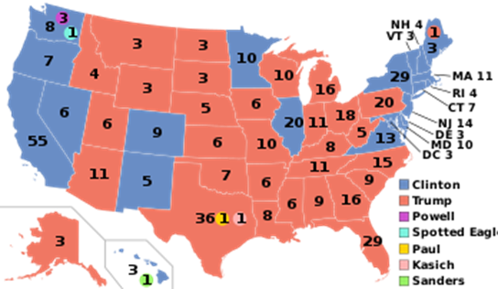
Clinton vs. Trump in 2016
Red shows the states won by the Republican candidate, Donald Trump while blue represents Democrats’ candidate Hilary Clinton. Trump garnered 304 votes while Clinton got 227 votes. Trump was declared the winner.
Notes:
Red shows the states won by the Republican candidate, Donald Trump while blue represents Democrats’ candidate Hilary Clinton. Trump garnered 304 votes while Clinton got 227 votes. Trump was declared the winner. Clinton had won the popular vote by more than 2 million votes.

Slide 7
Electoral college ignores the will of the people
The other argument against the electoral college is that it allows the election of a candidate who does not win the popular vote; hence it ignores the will of the people (Fortier, 2020).
This is seen as going against the will of the people.
The electoral college doesn't represent a popular national win.
The candidate with many popular votes is not guaranteed of being president, yet that was the will of the majority people.
In 2016, the will of the people was ignored when Hilary Clinton was not declared the presidential winner despite garnering more votes than Donald Trump who benefited from the system.
Notes:
With more than 330 million people, only 538 people are used to decide who becomes president. In 2016, Hilary Clinton won the popular vote yet lost the presidency. Despite winning the popular vote by 65,844,610 votes, Hilary Clinton did not become the US president because her closest competitor, Donald Trump, garnered more electoral college votes (304) than Hilary Clinton, who garnered 227 electoral college votes. This can be termed as “going against the will of the people.” The will of the huge number of voters is not put into consideration and only a handful of individuals who becomes the president. This is ignoring the will of the people.

Slide 8
Electoral college creates voter apathy
Lastly, it leads to voter apathy.
Opponents of the electoral college point out that the electoral college leads to low voter turnout because they feel that their vote will not in any case count in determining the presidential winner.
Therefore, they feel unnecessary and unworthy to cast their vote.
They also see it as a waste of time.
Notes:
Research shows that the electoral college creates voter apathy in whereby voters lose the morale of voting. The electoral college renders voters “useless” when their will is not granted. Thus, some voters may not turn out to vote because after all, their will won’t be granted. The voters feel that their votes won’t make any difference. In 2016, it is estimated that voters would have been more than the ones who voted, if electoral college was not in play (Fortier, 2020).

Slide 9
References
Amar, A. R. (2007). Some Thoughts on the Electoral College: Past, Present, and Future. Ohio NUL Rev., 33, 467.
Edwards III, G. C. (2019). The Faulty Premises of the Electoral College.
Edwards III, G. C. (2019). Why the Electoral College is bad for America? Yale University Press.
Fortier, J. C. (Ed.). (2020). After the people vote: A guide to the electoral college. AEI Press.

